Slide 1
The Reason Revolution
License and Terms of Use
Anyone may use this PowerPoint file to support presentations under the following terms:
No editorial or content changes may be made to any of the component slides.
Any slides, including this one, may be hidden to shorten presentation as necessary to fit time available.
Slides must be displayed in the order they appear in this file.
In preparation for presentations, users are expected to thoroughly read and fully comprehend the source e-book, The Reason Revolution: Atheism, Secular Humanism, and the Collapse of Religion by Dan Dana.
Users may use this resource for income-producing events with no financial obligation to the author.
Users are asked to encourage their audiences to download the free e-book at any online bookseller linked at www.dandana.us/atheism and to write an online book review at the download site.
Users may invite others to download and use this PowerPoint presentation under these terms of use.
www.dandana.us / atheism

Slide 2
The Reason Revolution
Atheism,
Secular Humanism,
and the Collapse of Religion
based on the free e-book by
Dan Dana, PhD
www.dandana.us / atheism

Slide 3
The Reason Revolution
The Reason Revolution in historical context
Questioning belief
Reasons for skepticism
Secular humanism as an alternative worldview
Political implications of atheism
The collapse of religion
Hopeful predictions
Reconciliation theories
www.dandana.us / atheism

Slide 4
The Reason Revolution
The Reason Revolution in historical context
Abraham, Jesus, Mohammed: Monotheism
Galileo vs Pope Urban, 1616
Newton, Einstein, Darwin, Hawking, Sagan
Religion conceding truth to science
Supernaturalism crumbling: 9% decrease from 2005
Reason overtaking faith
Secular humanism replacing religion
www.dandana.us / atheism

Slide 5
The Reason Revolution
The Reason Revolution in historical context
www.dandana.us / atheism

Slide 6
The Reason Revolution
Questioning belief
“Higher” power, consciousness after death
Zero evidence-based proof: Empirical, testable
“Holy” books, 2000 years old, pre-science mystics
Sagan: “Not a shred of evidence”
Science: Only valid approach to knowledge
www.dandana.us / atheism

Slide 7
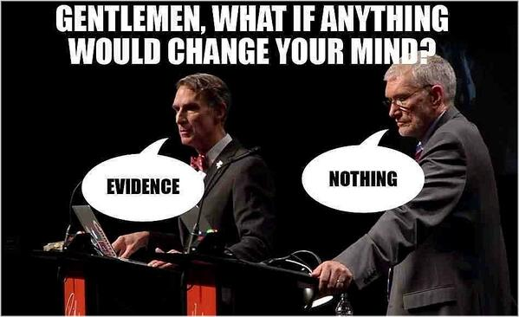
The Reason Revolution
Questioning belief
www.dandana.us / atheism

Slide 8
The Reason Revolution
Reasons for skepticism
Which religion is true?
Our insignificant place in the universe
The fact of evolution
The accidental human population
The disappearing “god of the gap”
Wishful thinking
Evident futility of prayer
Gullibility of followers
Most scientists are atheists
www.dandana.us / atheism

Slide 9
The Reason Revolution
Reason #1: Which religion is true?
12+ religions claim over 1 million believers (2014)
Significant differences (polytheism, reincarnation): We do not all “worship the same god”
100,000 religions invented, most extinct (Greeks)
All believers are certain of truth
How do you know?
All people are atheists re others’ gods
www.dandana.us / atheism

Slide 10
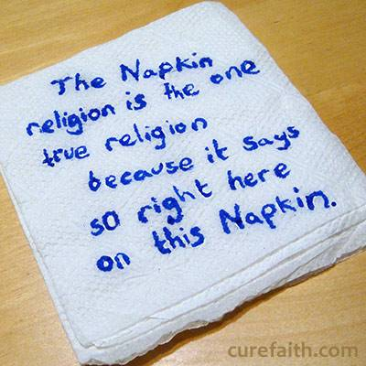
The Reason Revolution
Reason #1: Which religion is true?
Bible, Quran, Torah, and 10 other “holy books” make the same circular claim.
www.dandana.us / atheism

Slide 11
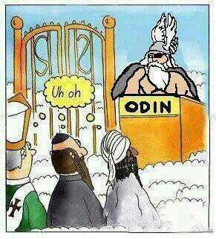
The Reason Revolution
Reason #1: Which religion is true?
www.dandana.us / atheism

Slide 12
The Reason Revolution
Reason #2: Our insignificant place in the universe
Milky Way: 400 bn stars, 30 bn Earth-like planets
100 bn galaxies = “zillion” possible life-host planets
Humans exist 0.0000036% of time since Big Bang, 0.0014% of time of Earth (sun to become red giant)
Creator did all this for us?
Religious delusion of self-importance
www.dandana.us / atheism

Slide 13
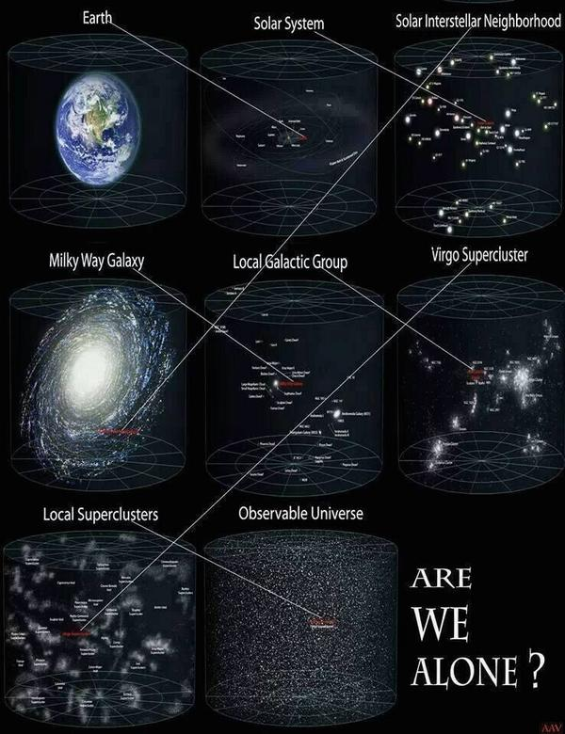
The Reason Revolution
Reason #2: Our insignificant place in the universe
Dimensions of spacetime are unimaginably large … and small.
www.dandana.us / atheism

Slide 14
The Reason Revolution
Reason #3: The fact of evolution
“Theory” (like gravity)
Last universal common ancestor (LUCA) 3.7 bya
Human cousins: reptiles, insects, plants, fungi
No generation had animal parents and human children
When was human “soul” installed?
Or, do mosquitoes, frogs, mushrooms also have souls?
www.dandana.us / atheism

Slide 15
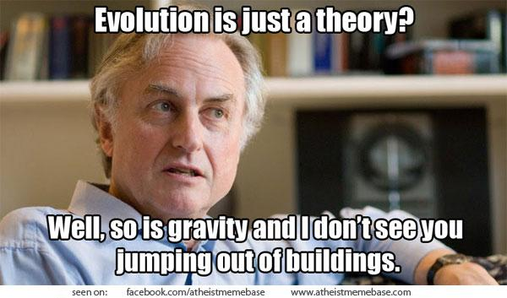
The Reason Revolution
Reason #3: The fact of evolution
www.dandana.us / atheism

Slide 16
The Reason Revolution
Reason #4: The accidental human population
Our concestor lived before modern religions appeared (at least 17,000 years ago)
Impregnation of concestor’s mother: 40+ million competing sperm
If a different sperm had won race to her egg, then different human population thereafter, including founders of religions (no Jesus)
www.dandana.us / atheism

Slide 17
The Reason Revolution
Reason #5: The disappearing “god of the gap”
Early deities: sun, seasons, fertility, other mysteries
As science advanced, religious authorities admitted “gods” were natural processes
Pope/Saint John Paul II: “Truth cannot contradict truth” (faith/science)
Gap between scientific knowledge and mystery narrowing
Mysteries remain, but how best to explain?
www.dandana.us / atheism

Slide 18
The Reason Revolution
Reason #5: The disappearing “god of the gap”
www.dandana.us / atheism

Slide 19
The Reason Revolution
Reason #6: Wishful thinking
Psychology: People believe to be true what they wish to be true:
Wise, loving, powerful, protective (male) god
Idyllic afterlife, reunification with loved ones
Hoping for relief from anxiety, despair, loss
Yearning to meet again (love, loss, grief)
Susceptible to clergy assurances, conflict of interest?
Zero evidence: Figments of wish fulfillment?
www.dandana.us / atheism

Slide 20
The Reason Revolution
Reason #7: Evident futility of prayer
Studies: No efficacy of intercessory prayer
Desperate please go unheard (Holocaust)
Cop-out: “God works in mysterious ways”
Which conclusion?
God isn’t listening
God doesn’t care
God is powerless to intercede
God doesn’t exist
www.dandana.us / atheism

Slide 21
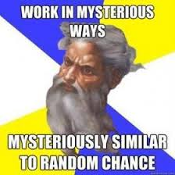
The Reason Revolution
Reason #7: Evident futility of prayer
www.dandana.us / atheism

Slide 22
The Reason Revolution
Reason #8: Gullibility of followers of religious leaders
Leadership trade-off: “We’ll let you tell us what to believe, if you’ll promise to lead us to desired outcome”
Followers and leaders seduce each other, share deluded belief in truth of doctrine
Belief system becomes institutionalized, resistant to change (Catholic hierarchy)
Blind to own motives: Pedophiles “love” children
www.dandana.us / atheism

Slide 23
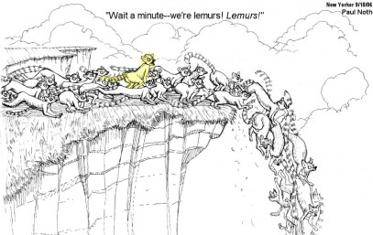
The Reason Revolution
Reason #8: Gullibility of followers of religious leaders
www.dandana.us / atheism

Slide 24
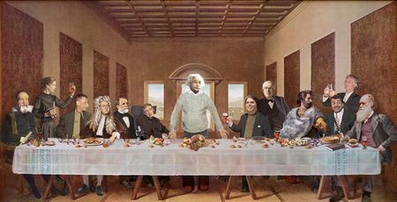
The Reason Revolution
Reason #9: Most scientists are atheists
93% of National Academy of Sciences are atheists
Whom shall we trust for good thinking?
Brilliant scientists who objectively investigate, test
Uneducated pre-science mystics of 2000 years ago
www.dandana.us / atheism

Slide 25
The Reason Revolution
How to reconcile scientific findings (reasons for skepticism) with religious faith?
Choices:
Accept science
Accept ancient supernatural dogma unsupported by evidence
Don’t think about it (avoid cognitive dissonance: discomfort from holding beliefs inconsistent with recognized facts)
www.dandana.us / atheism

Slide 26
The Reason Revolution
Secular humanism as an alternative worldview
Highest value is the well-being of human and sentient non-human animals
Accept that this life is the only one
Accept that there is no “higher power” to rely on
Accept that nothing “supernatural” exists: All reality is natural
Accept that we can be “good without gods”: Responsible for our own moral behavior
www.dandana.us / atheism

Slide 27
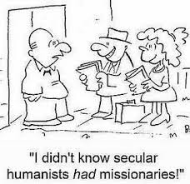
The Reason Revolution
Secular humanism as an alternative worldview
www.dandana.us / atheism

Slide 28
The Reason Revolution
Political implications of atheism
Personal theology does not matter unless leaders impose theirs on citizens via enforced policy
Church/state separation is essential for democracy
Theocracies always fail to serve the natural needs of citizens
Citizens of “Christian nations” and “Islamic states” are necessarily oppressed.
www.dandana.us / atheism

Slide 29
The Reason Revolution
Political implications of atheism
www.dandana.us / atheism

Slide 30
The Reason Revolution
Political implications of atheism
Religion-infused policy issues include:
Property tax exemption
Teaching of pseudoscience (creationism and ID)
Restriction of early-term abortion
Opposition to birth control
Prohibition of voluntary euthanasia
Discrimination against LGBT people
Faith-based sex education
Prayer in public schools, military, Congress
“Under God”, “In God we trust” endorsement of religion
Attempts to base civil and criminal law on Ten commandments, Sharia
Failure to protect animal rights
Others … ?
www.dandana.us / atheism

Slide 31
The Reason Revolution
Political implications of atheism
www.dandana.us / atheism

Slide 32
The Reason Revolution
The collapse of religion
Tipping point, paradigm shift, when majority of voters are atheists
Model: Gay rights in USA
Within this century in North America (Europe now?), longer in Muslim theocracies
Pockets of contrarians will persist (like Flat-Earthers)
Requires near-universal science-based education
Obstacle: Human propensity to invent myths
www.dandana.us / atheism

Slide 33
The Reason Revolution
The collapse of religion
www.dandana.us / atheism

Slide 34
The Reason Revolution
Hopeful predictions
First openly atheist U.S. President
Candidates can come out, faith-professing candidates will be dismissed as oddities
U.S. Congress rescinds laws that encode religion
Religion disappears as a source of polarization
Supreme Court justices come out, end of unconstitutional intrusion of region into law
Marriage (religious rite) replaced by secular civil union, same-sex partners treated equally under the law
God-believers become isolated anti-intellectual groups
www.dandana.us / atheism

Slide 35
The Reason Revolution
Hopeful predictions
Final Pope resigns, Vatican repurposed as art museum
Religion-inspired violence will cease (Islamic terrorism, Christian persecution of gays, execution of apostates)
Religion-based violence toward women will cease (genital mutilation, forced marriage, honor-killing)
Droves of the formerly religious exclaim, “How could I have believed that myth!
Social ethics and morality unhinged from religion
Religious holdouts viewed like teenage Santa believers
www.dandana.us / atheism

Slide 36
The Reason Revolution
Reconciliation theories
Science is correct, but faith comforts, so belief is important
Science not yet advanced enough to discover God, Heaven
Bible (or other holy book) is the sole source of truth, science is wrong despite appearance of rationality
Science is an invalid method, irrelevant to search for truth
Science is Satanic, a temptation of the faithful
A higher (supernatural) reality exists that science can’t examine, accessible only by faith
God = universe (pantheism)
Agnosticism: Truth is unknowable, proof is impossible
www.dandana.us / atheism

Slide 37
The Reason Revolution
Reconciliation theories
www.dandana.us / atheism

Slide 38
The Reason Revolution
Call to action
Read, recommend, and review The Reason Revolution
Send download link via social media
Follow Dana2atheism on Twitter
Authors, reference this material in your writings
Students, write term paper on this topic
Humanity will thank you!
Download this PowerPoint presentation,
a reproducible handout (PDF),
and The Reason Revolution sourcebook
FREE at:
www.dandana.us / atheism

